Slide 1
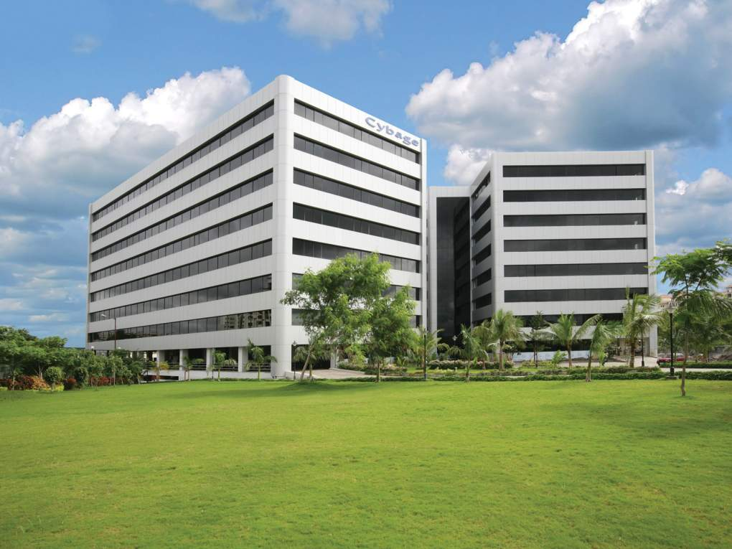

Docker
This document and all its contents contain information from Cybage Software Private Limited which may be privileged, confidential, or otherwise protected from disclosure. The information is intended to be for the addressee(s) only. Any unauthorized disclosure, copy, distribution, or use of the contents of this message is strictly prohibited.

Slide 2
Agenda
Infra team – Pain areas
Why Containers?
Docker
Use cases for Docker
Delivery Pipeline with Containers
Green/Blue Deployment Using Docker
CoreOS – cluster management
Evolution in Virtualization History
Docker vs KVM

Slide 3
Infra team – Pain areas
Dev, Test, Prod environments are different
Prod Env –
Downtime issues
Fire fighting issues
Golden Images
Higher Cost – at machine/VM level
Higher storage requirements
Manual process of creating Environments - for Dev, Test teams
How to Snapshot the Environments
Manual release process

Slide 4
DevOps value addition to Infra team
Same environments for Dev, Test and Prod
No downtime
Faster to create/manage Environment
Easy to take Snapshot of Environment
Easy to build, test and deploy Apps
Deployment Automation
Faster and more releases
Lower cost on storage and CPU
Portability of Apps
Green/Blue deployment

Slide 5
Docker
What is Docker?
Docker automates creation of lightweight - Application container
Container will virtually run anywhere
Same container can run on any laptop, desktop, VM, Cloud & more
Deployment of Applications inside an Container
Unlike VM, it does not include a separate Operating system.
Why Docker ?
Speed: Boots in seconds
Footprint: 100-1000 containers on one machine
Small Disk/CPU requirements as compared to VM's
Portability
Supported by all Cloud providers

Slide 6
Why Containers ?
Faster delivery of Applications
Containers help Dev, Test & Ops teams to work together
Simplifies management & deployment of code
“Unit of Deployment”
Containers have Sub second launch times
Reducing the cycle time of development, testing and deployment

Slide 7
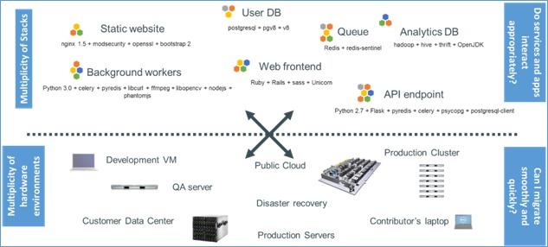
Challenge of Multiple Environments

Slide 8
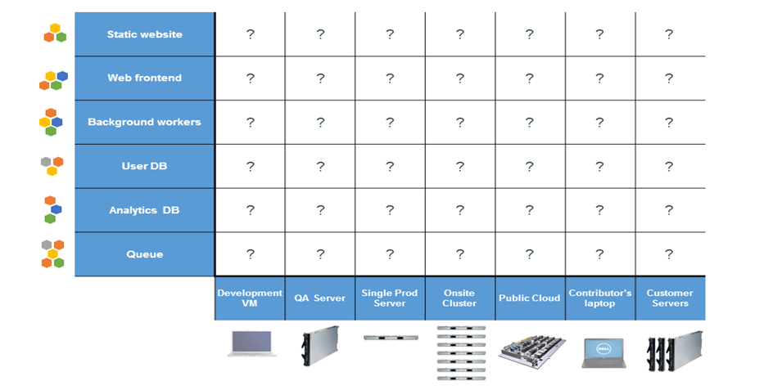
The Matrix From Hell

Slide 9
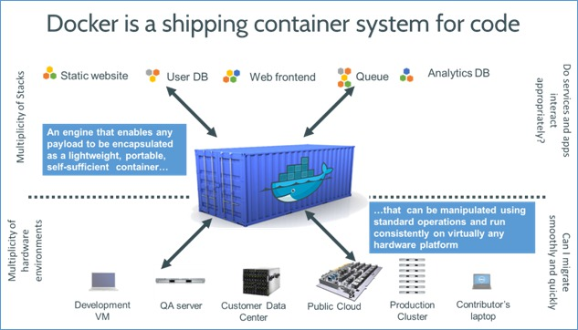
Ship an Application Container

Slide 10
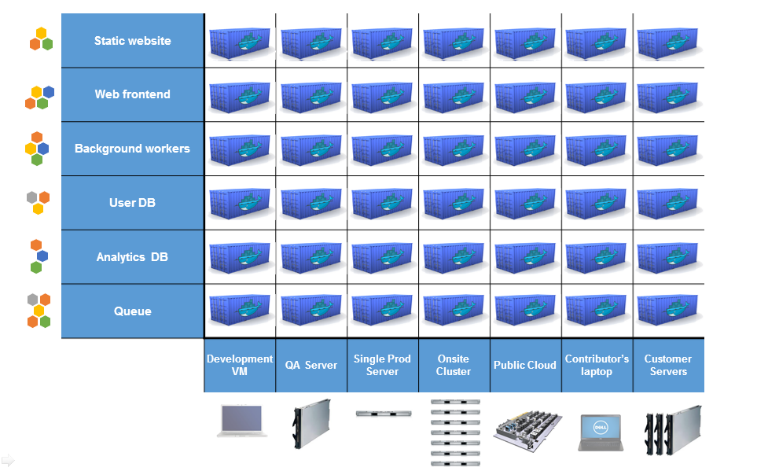
Docker eliminates the matrix from Hell

Slide 11
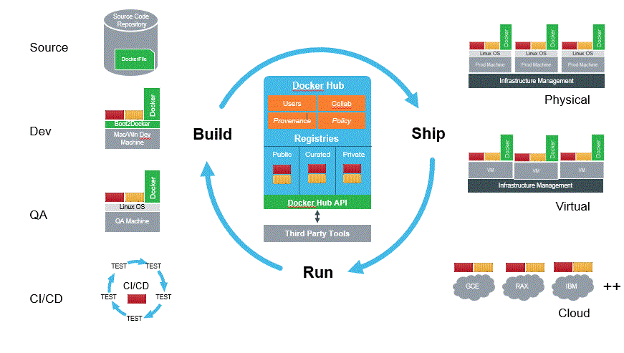
Docker – Build , Ship And Run Apps

Slide 12
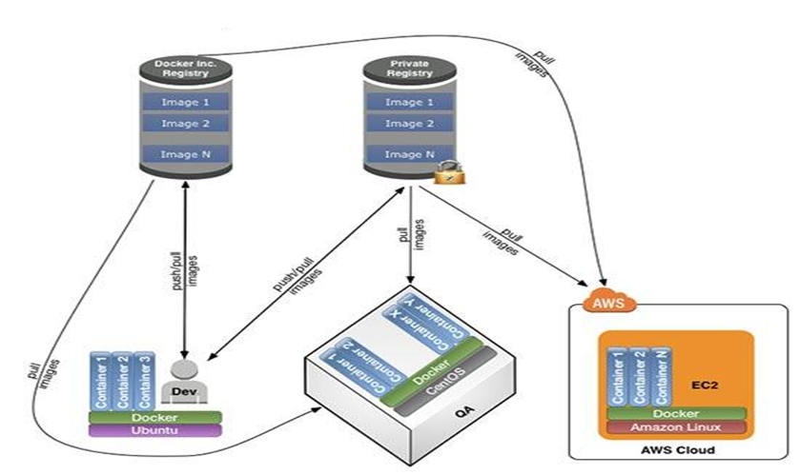
Docker – Dev, Test & Prod Environments

Slide 13
Docker – value addition for DevOps
Fast
Runtime performance near bare metal speeds
Management operations (run, stop , start, etc.) in seconds / milliseconds
Agile
VM-like agility – it’s still “virtualization”
Flexible
Containerize “application(s)”
Lightweight
Does not have its own Operating System, like a VM
Images only contain bin, lib and app
Inexpensive
Open source – free – lower TCO
Supported with out-of-the-box modern Linux kernel
Ecosystem
16,000+ Apps in Docker Hub
Vibrant community & numerous 3rd party app
All Cloud providers - AWS, VMware, Google App Engine support Docker

Slide 14
Why Should I Care (For Developers)
Simple creation of Environments
Portable App containers
Build, test & package on production like environment
Increase the quality of code produced by Developers
Fast and simple
16,000+ apps available on Docker Hub

Slide 15
Why Should I Care (For DevOps)
Provide standard Environments for Dev, Test & Production
Reducing “works on my machine” finger-pointing
Helps Infra teams to deploy & run any App on any infrastructure
Entire lifecycle more efficient and repeatable
Compared to VM's, reduces costs & improves speed
Deployment & Release Automation
Perfect for DevOps – CI, CD, Release, Scaling, Clouds, etc

Slide 16
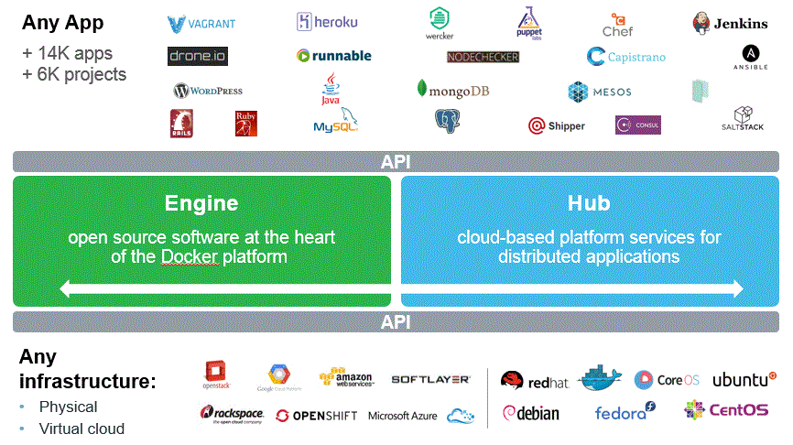
Docker - Ecosystem

Slide 17
Use cases for Docker
Automating packaging & deployment of Applications
Continuous integration/deployment
Automated testing
Zero downtime
Creation of PAAS environments
Scaling Web apps, databases and backend services
Micro-services architecture / Service orchestration & discovery

Slide 18
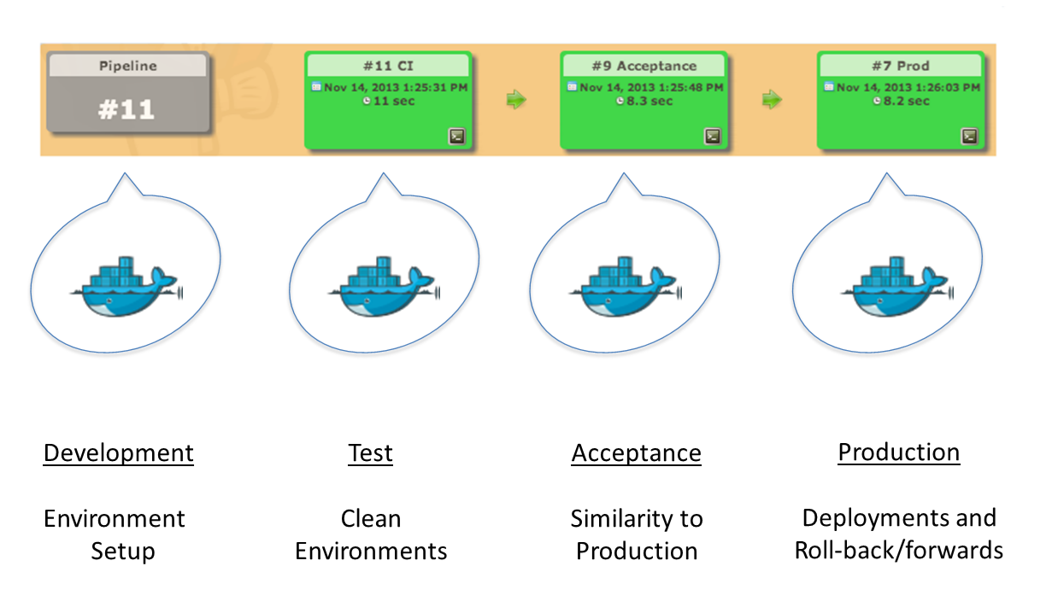
Delivery Pipeline with Containers

Slide 19
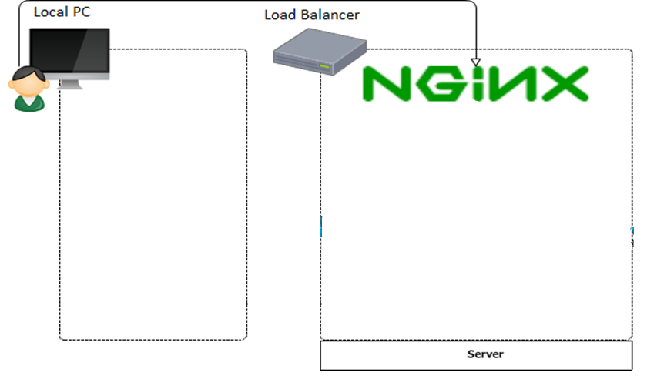
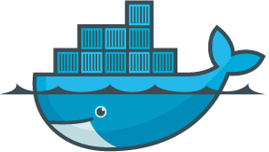

Green/Blue Deployment Using Docker
Push
Pull
Pull
Push
docker-registry
docker

Slide 20
Green/Blue Deployment Using Docker
Push
Pull
Pull
Push
docker-registry
docker

Slide 21
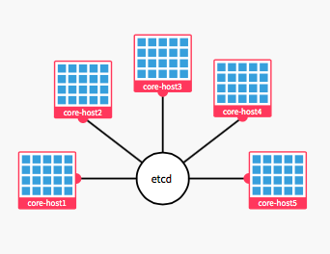
CoreOS – cluster management

Slide 22
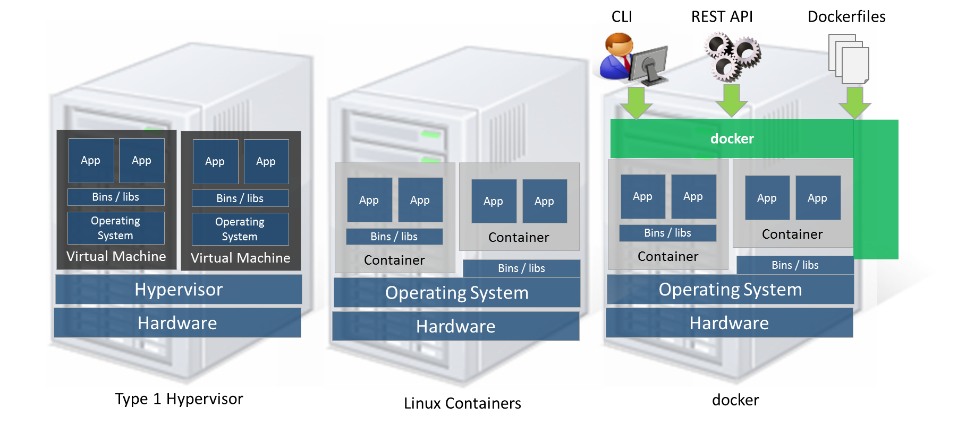
Evolution in Virtualization History

Slide 23
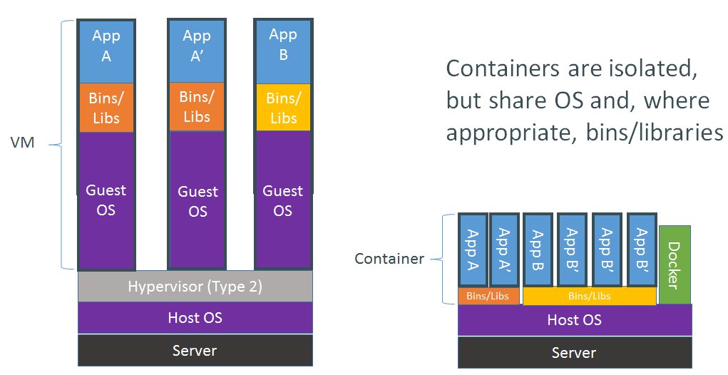
Docker Container vs VM

Slide 24
Docker vs KVM - Server Boot time

Slide 25
Docker vs KVM - Server Compute CPU

Slide 26
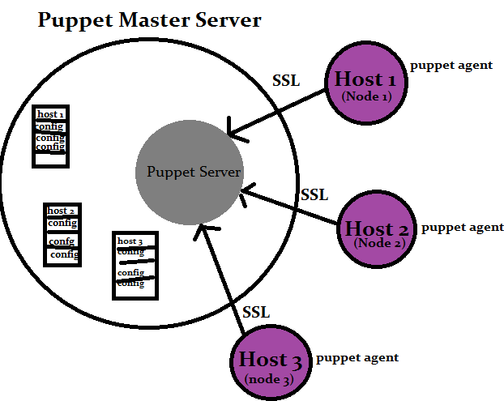
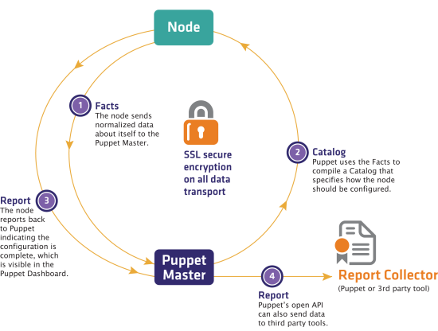
Puppet
Puppet as Configuration Management tool can manage Docker
Docker hosts management
Docker Engine installation
Start Docker containers
Build Docker images
Handle the inside of running containers

Slide 27
Any Questions?

Slide 28
Thank You!

